Slide 1
6-1 Classifying Quadrilaterals
M11.C.1 2.9.11.C
Objectives:
To define and classify special types of quadrilaterals.

Slide 2
Special Quadrilaterals
Parallelogram – is a quadrilateral with both pairs of opposite sides parallel.
Rhombus – is a parallelogram with four congruent sides.
Rectangle – is a parallelogram with four right angles.

Slide 3
Special Quadrilaterals
Square – a parallelogram with four congruent sides and four right angles.
Kite – is a quadrilateral with two pairs of adjacent sides congruent and no opposite sides congruent.

Slide 4
Special Quadrilaterals
Trapezoid – is a quadrilateral with exactly one pair of parallel sides.
Isosceles Trapezoid - is a trapezoid whose nonparallel sides are congruent.

Slide 5
Classify the Shape
Judging by appearance, classify
each shape in as many ways as
possible.

Slide 6
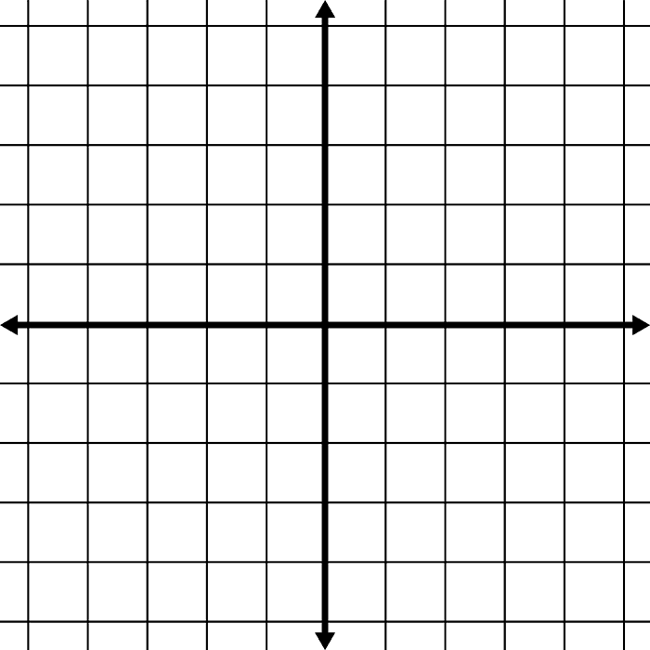
Classify – Determine the most precise name for the quadrilateral
Determine the most precise name for the quadrilateral.
Step 1: Find the slope of EACH side. (Why must we find slope?)
Step 2: Use the distance formula to find the length of EACH side. (Why must we find the distance?)

Slide 7
Slope and Distance
Slope Formula:
Distance Formula:

Slide 8
Example
Determine the most precise name for quadrilateral ABCD with vertices A(-3,3), B(2,4), C(3,-1), and D(-2, -2).

Slide 9
Example: Classify
In a parallelogram RSTU
m∠R = 2x – 10
m∠S = 3x + 50
Find x

Slide 10
Example
In kite ABCD, AB=BC and CD=DA.
AB = 2y + 5
BC = x + 6
CD = 3x – 5
DA = 2x + 4
Find x and y.

Slide 11
Classwork
HANDED – IN
Page 290 #1-12, 19-24, 37-42

